Slide 1


Taylor Southwick
Mechanical Design Engineer

Slide 2

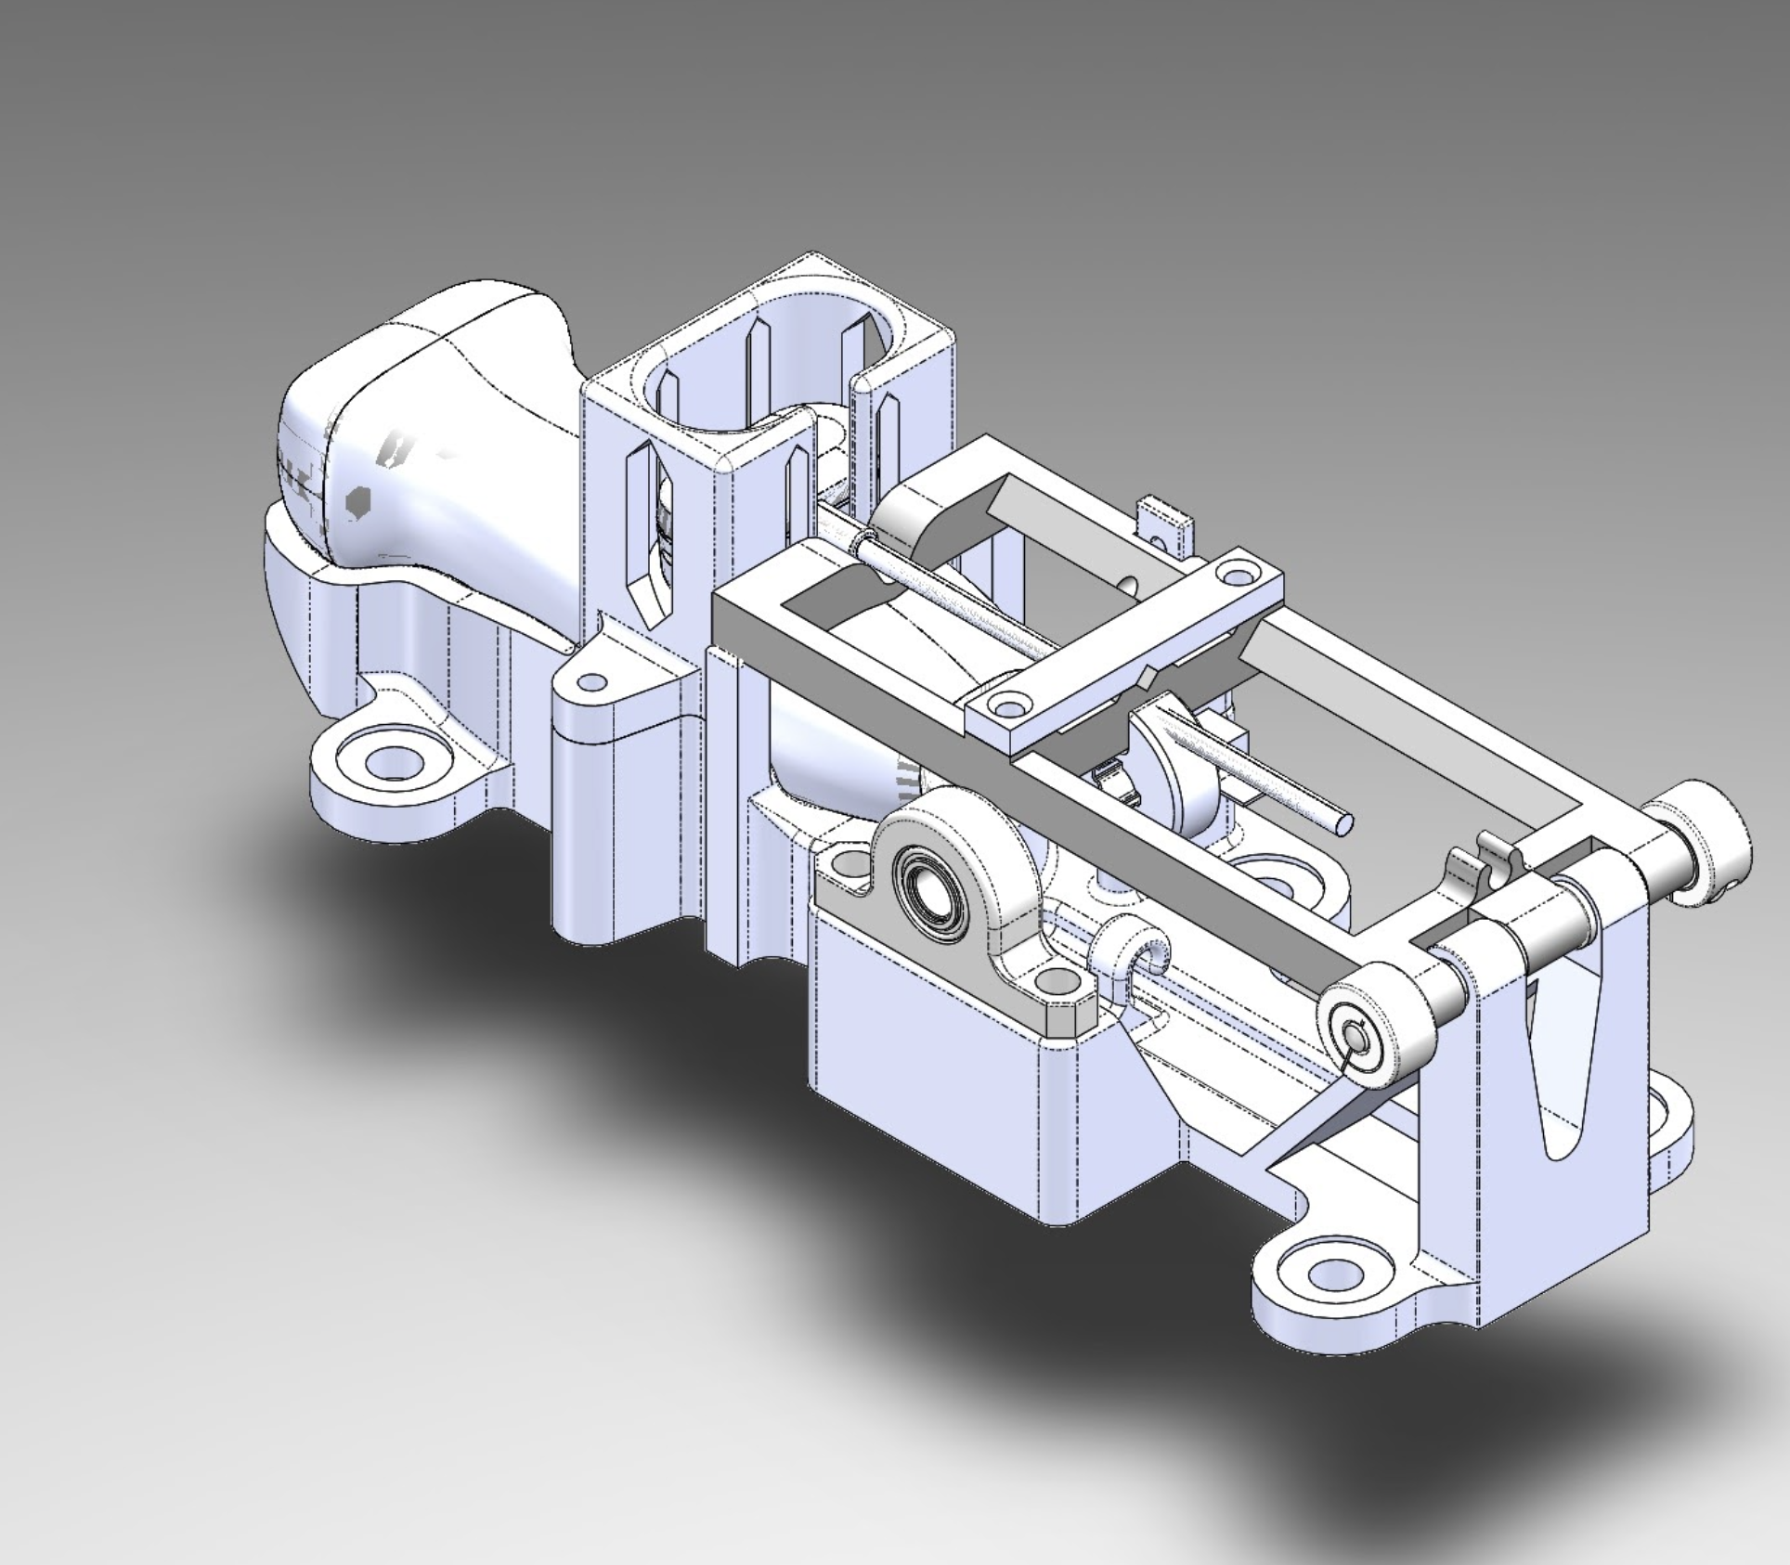
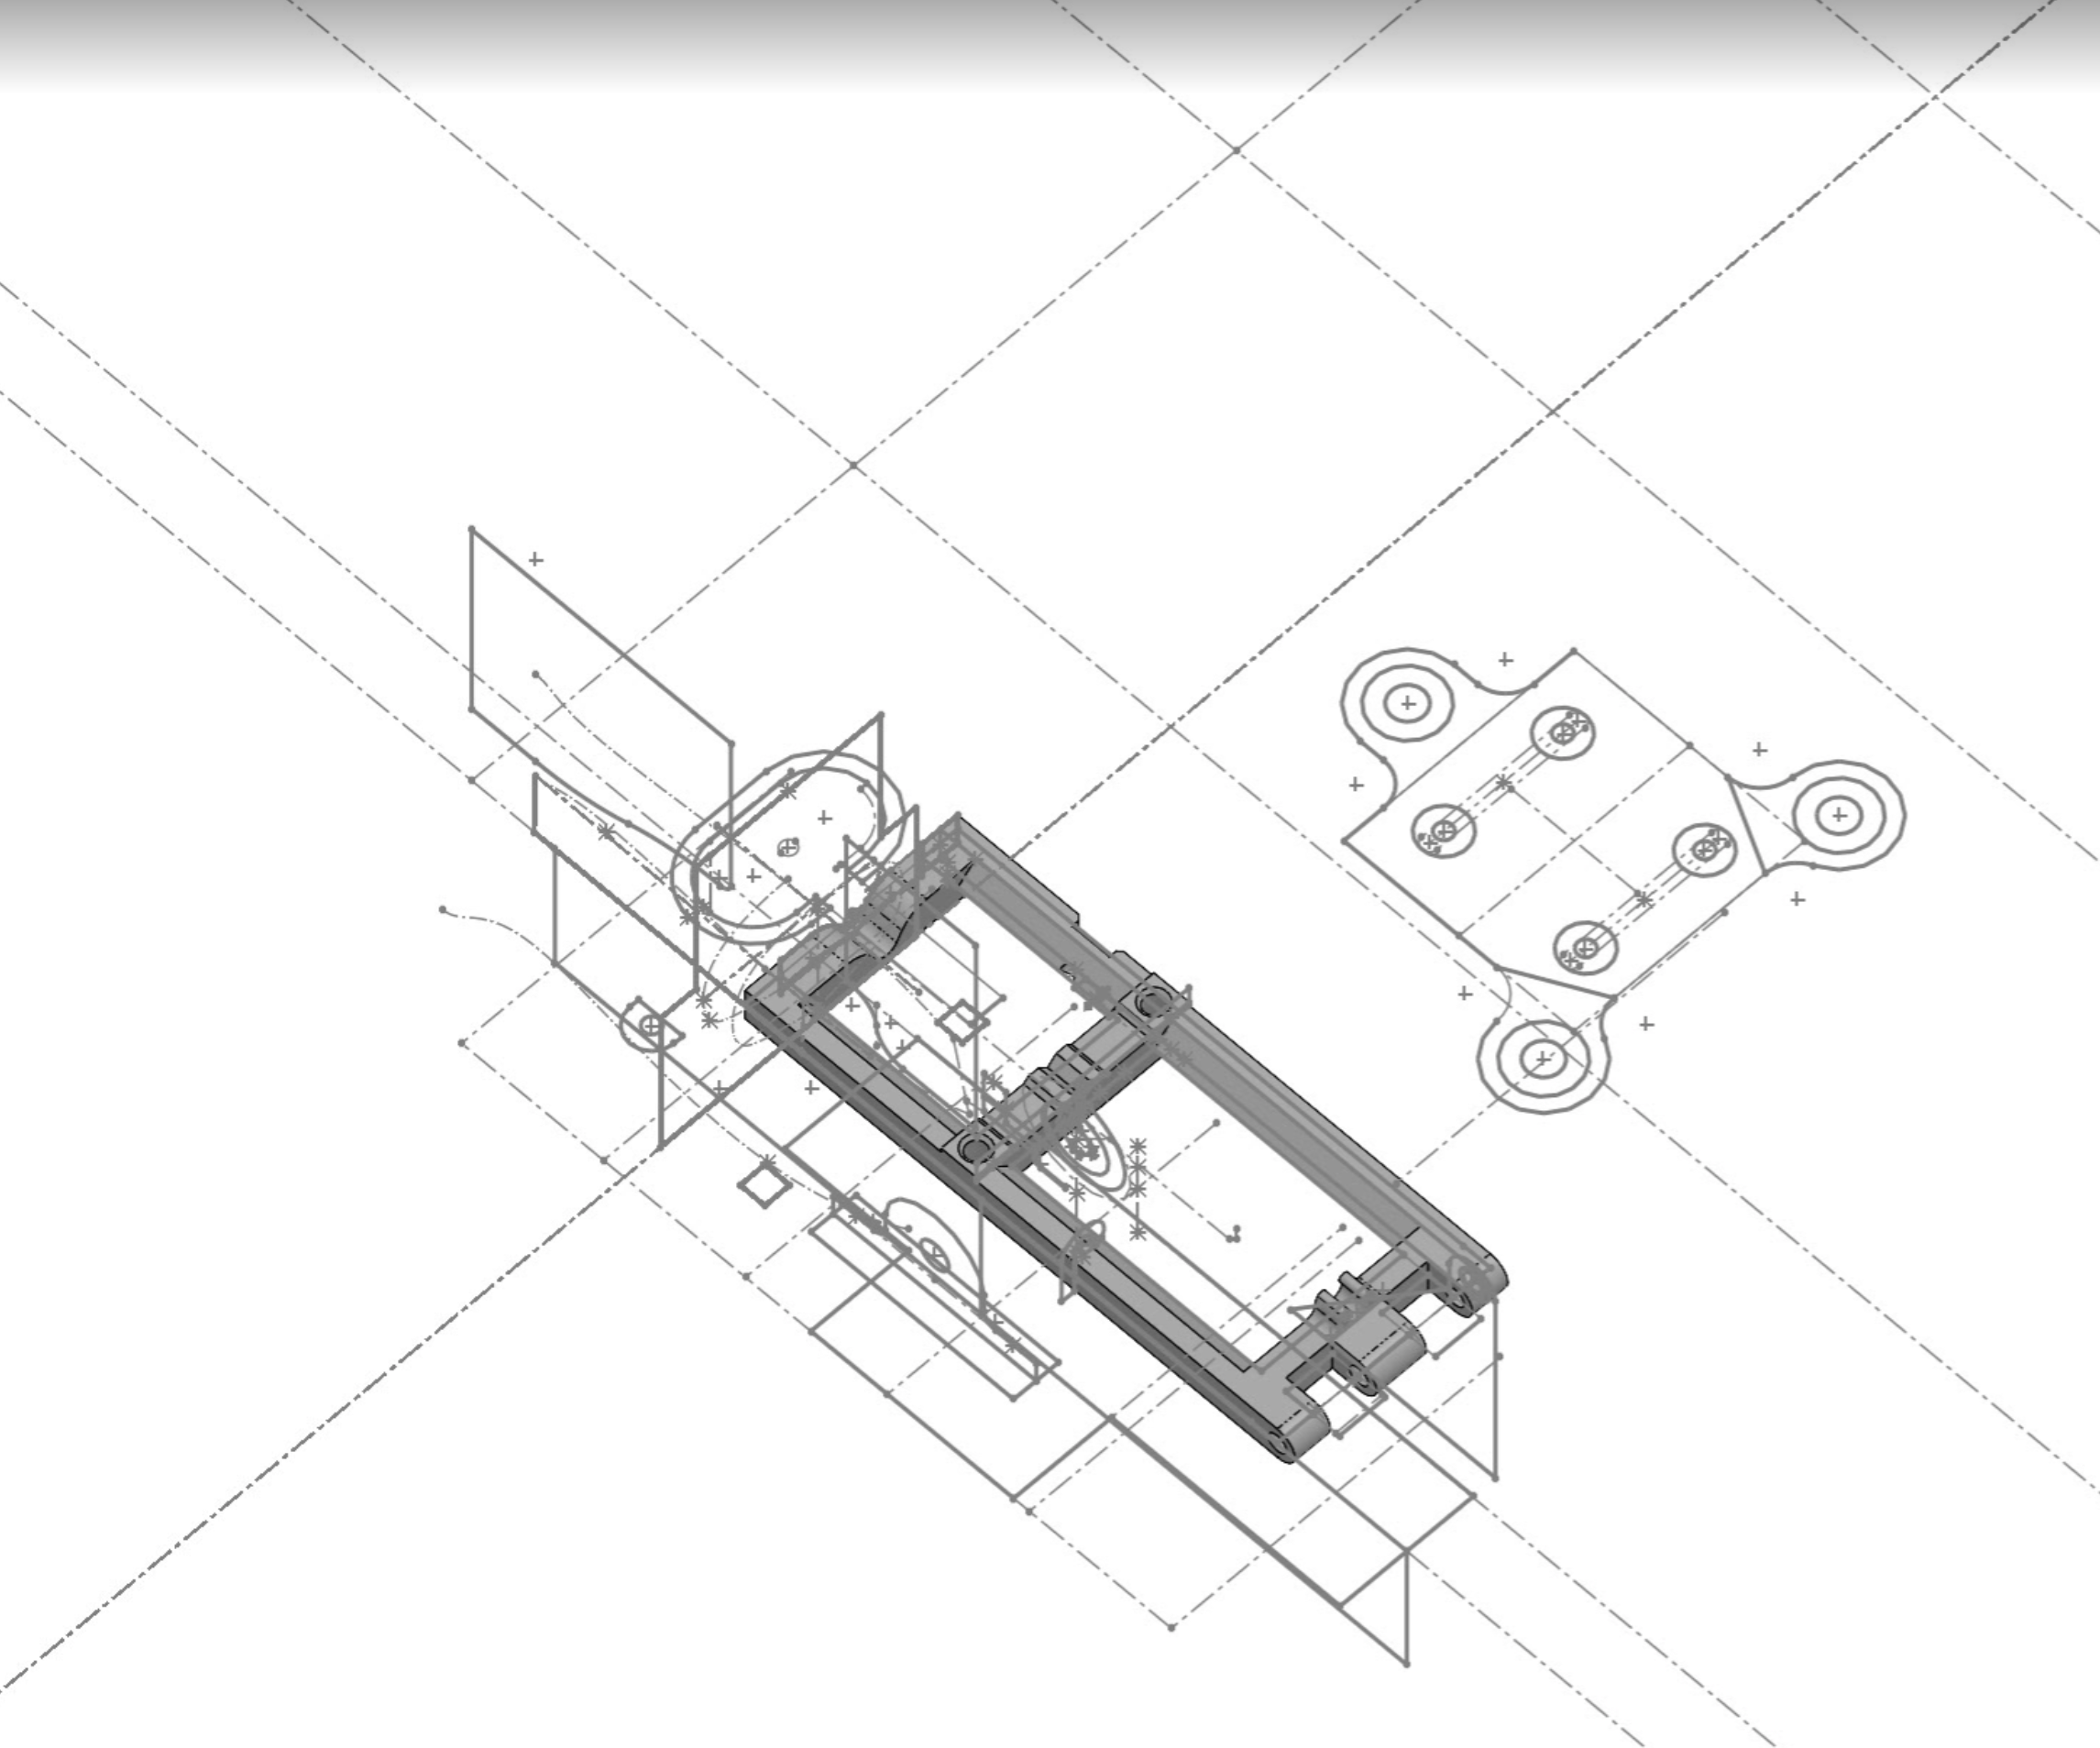
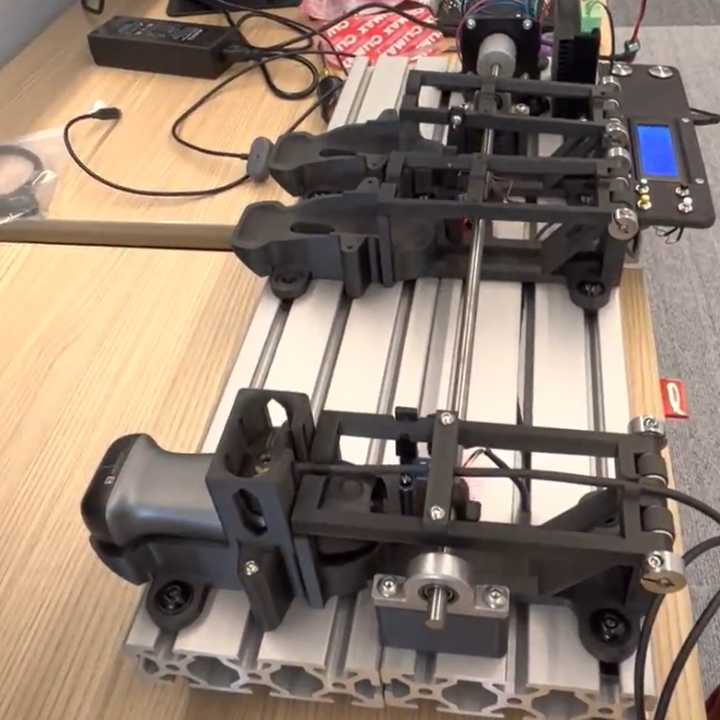
Cycle Tester
Designed to automate testing the contact of the charger and the probe thousands of times.
Most important properties required were reliability, durability, and the ability to run a specific number of tests without oversight.
Used Solidworks and Master modeling to design an assembly comprised of 3D printed and off the shelf parts that form an easily adjustable assembly.
Prototyped over several design iterations to get a very robust final design
Final product runs four probes simultaneously and was effective in completing the important testing of multiple prototypes.
Project resulted in documentation which was written to guide future testing rigs.

Slide 3

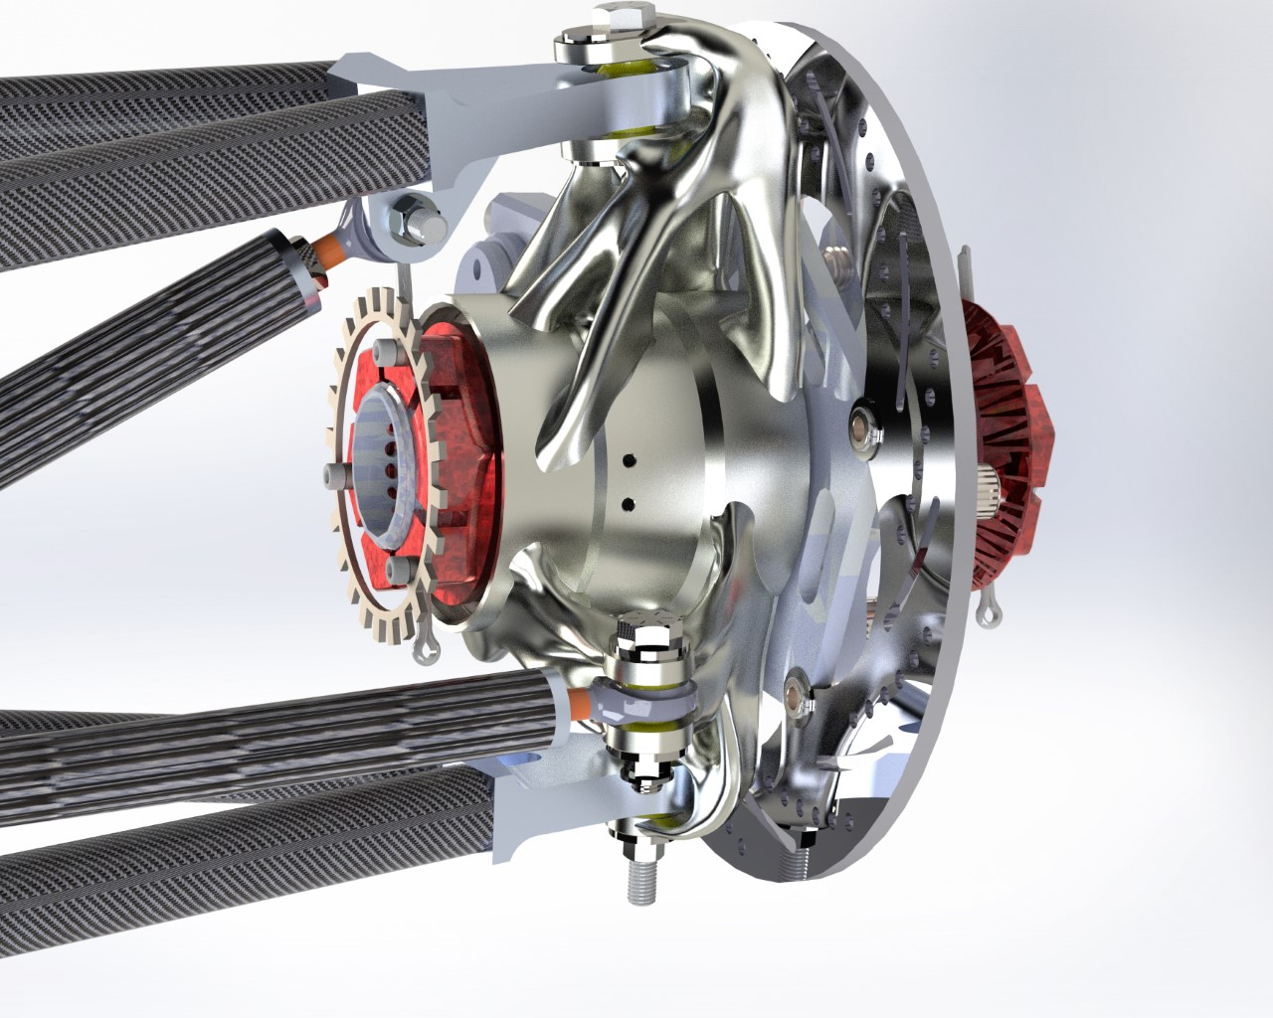
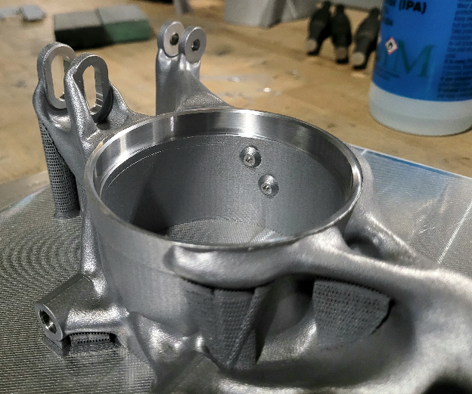
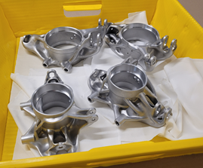
Generative Design Upright
The Uprights are an essential part of any racecar which house the hubs and hold the wheels in place via connections to the frame.
The part was designed using generative design in fusion 360 and verified using FEA in Ansys.
Final model was 3D printed with AlSi10Mg and post machined for bearing surfaces, bolt holes, and tapped holes.
Final Design reduced the number of parts from the previous year’s design by 96 by removing adapters required to simplify manufacturing on a 5 axis mill and simplifying the sensor mounts and the weight reduction was 7%

Slide 4
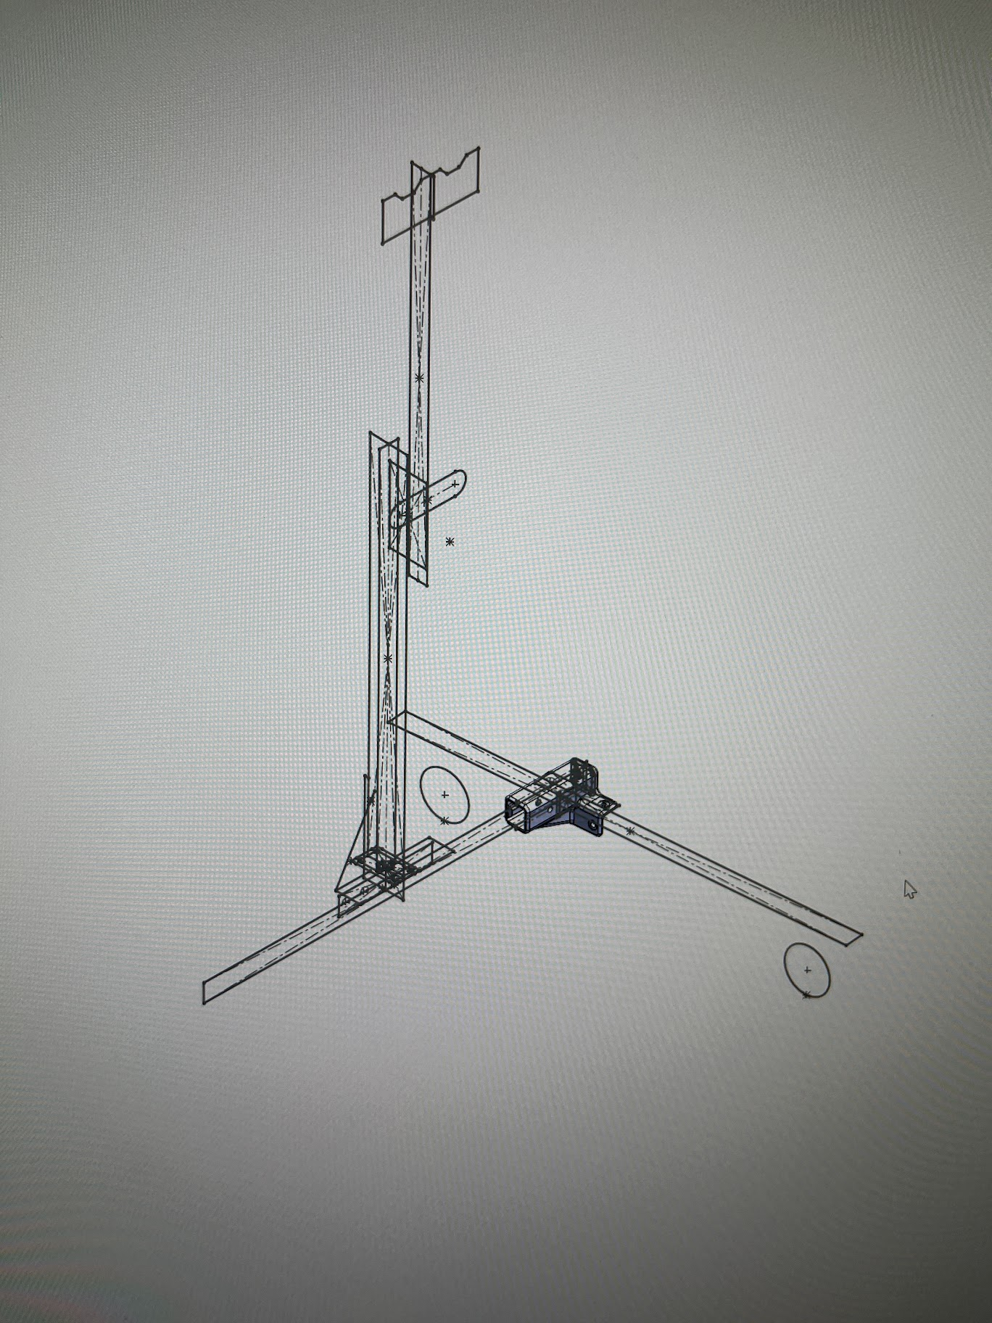
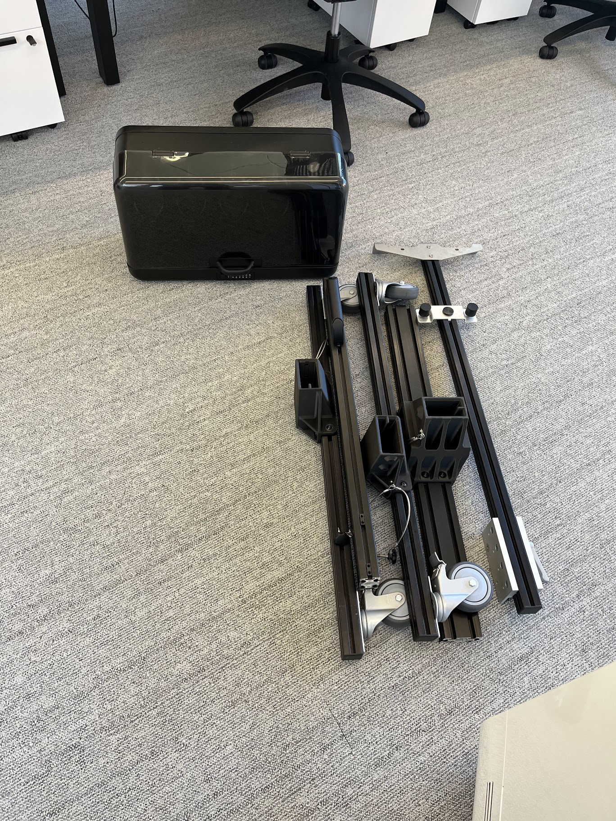
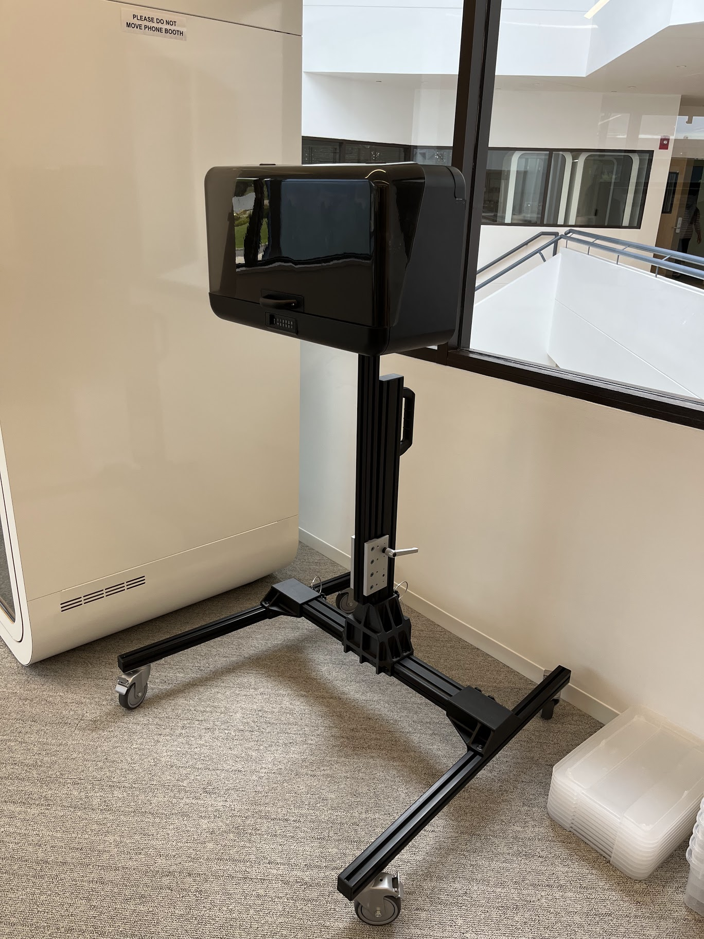
Portable Wall Mount
The ask was a portable cart which could display a wall mounted storage chest for use in prototyping, trade shows, and in hospitals.
Modeled the cart with an adjustable height for different prototypes and chests.
Was designed in Solidworks and parts were machined, 3D printed, and off the shelf.
The final assembly can hold a 60lb chest and is fully collapsible
Can be easily assembled and travels in a case which can be brough on an airplane.

Slide 5
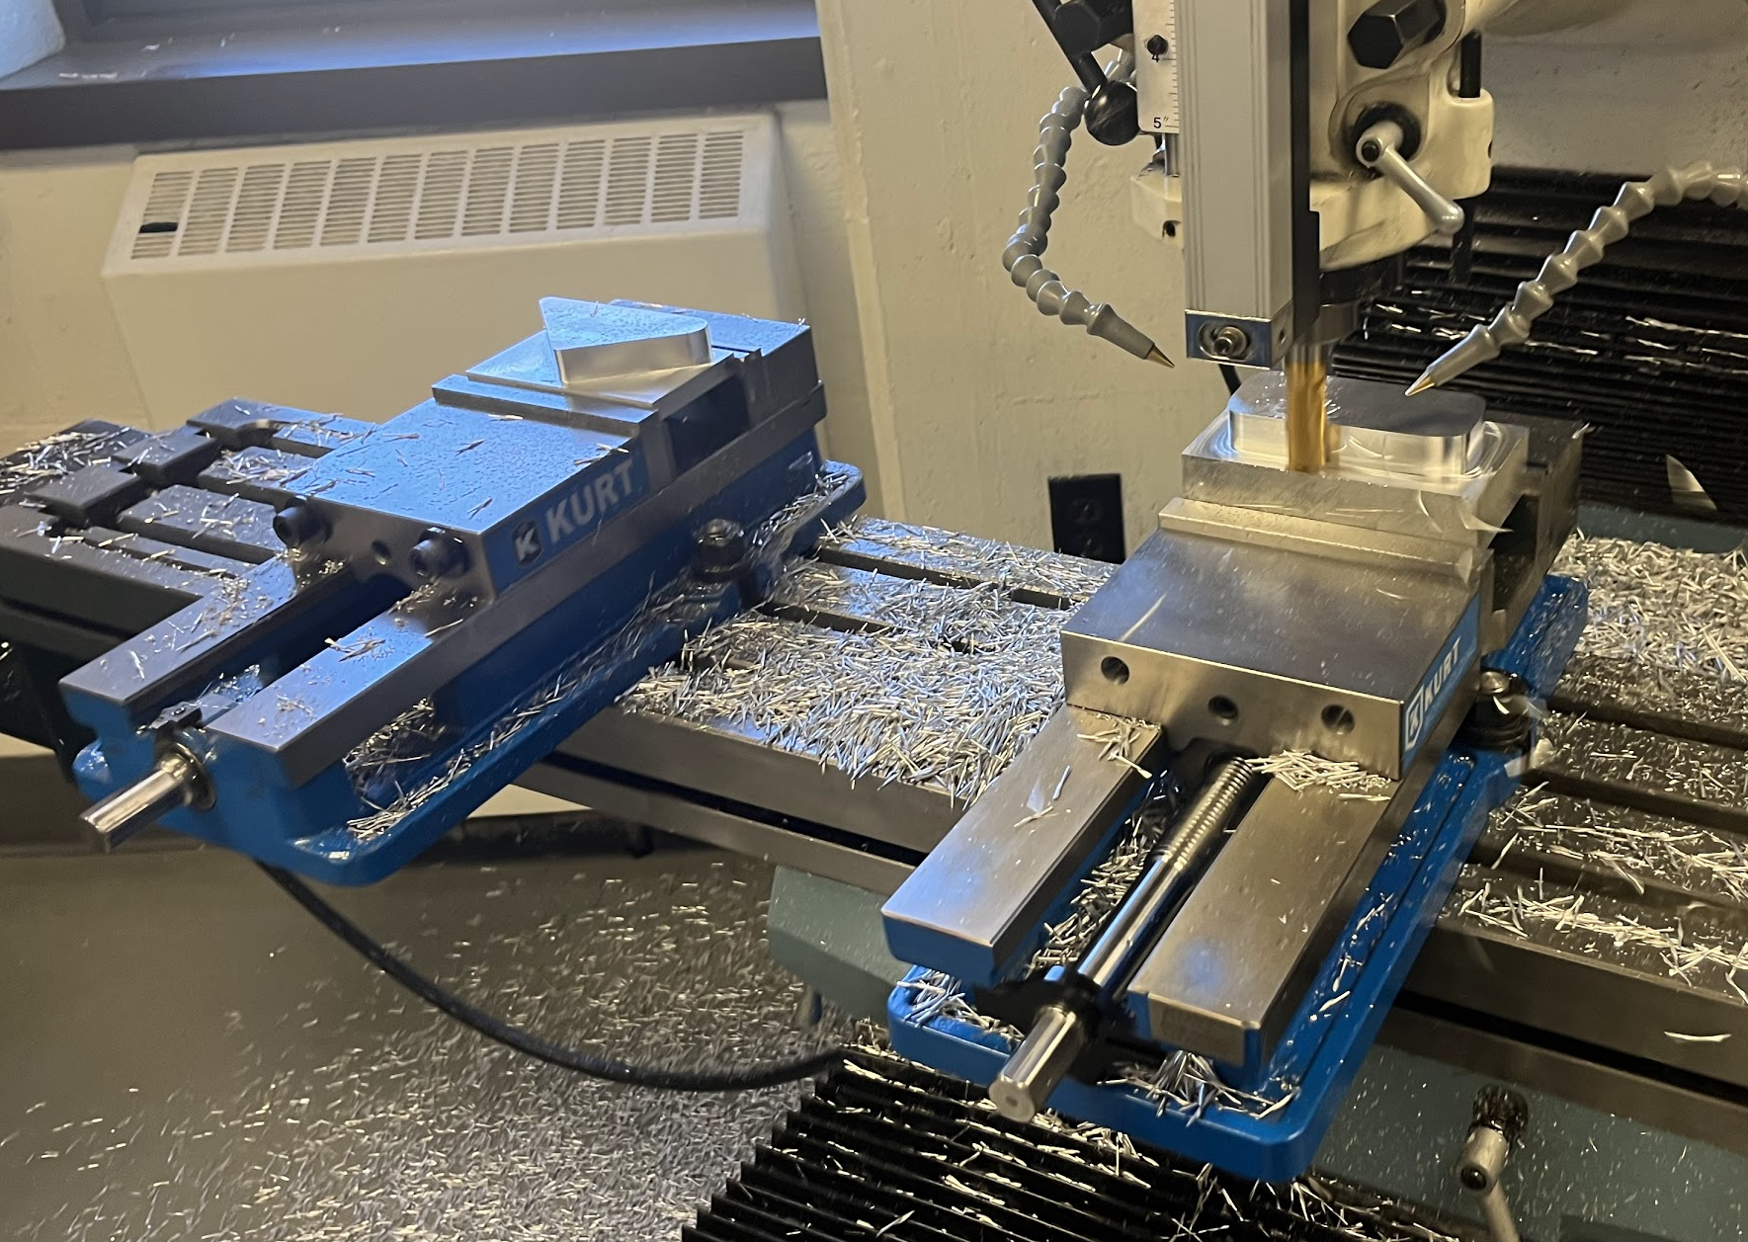
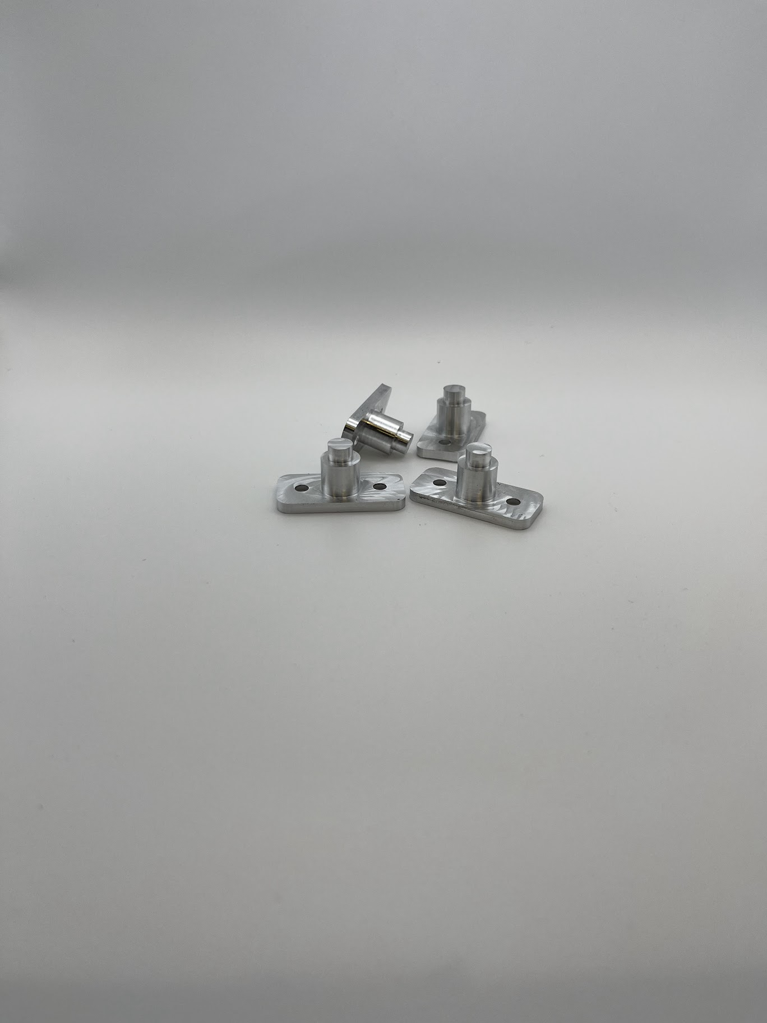
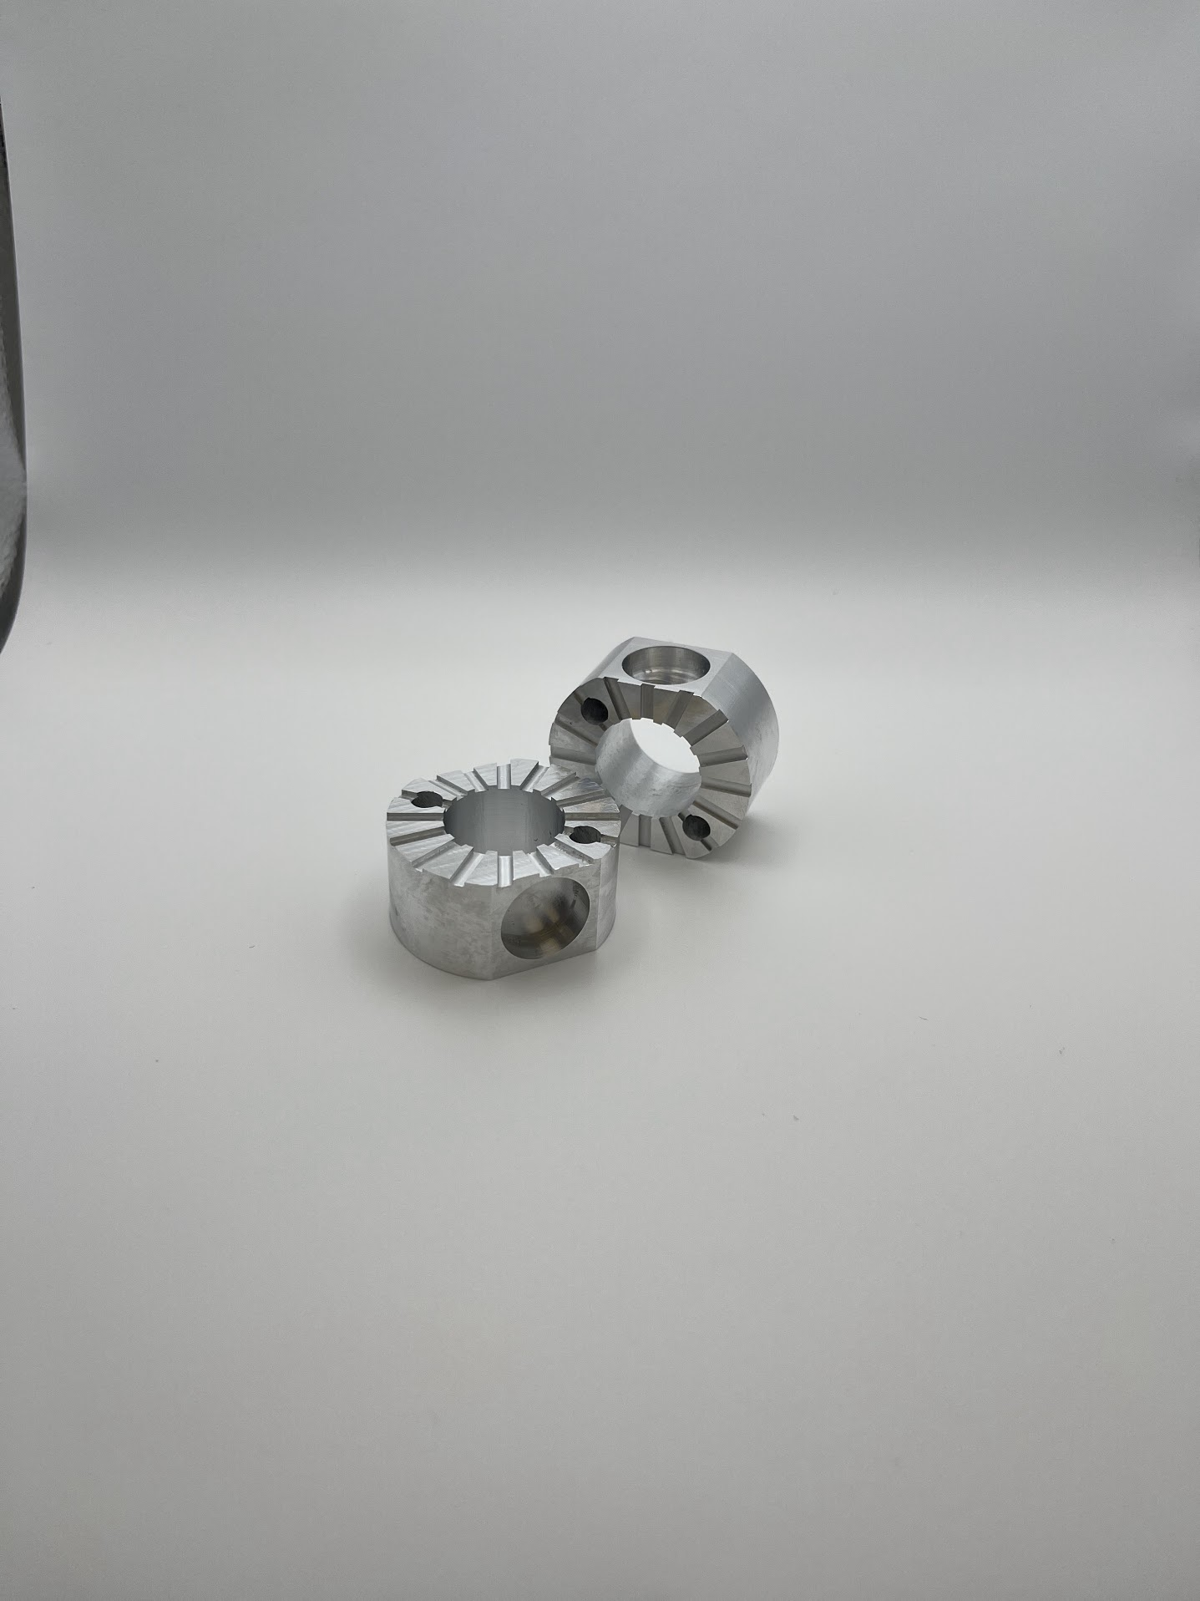
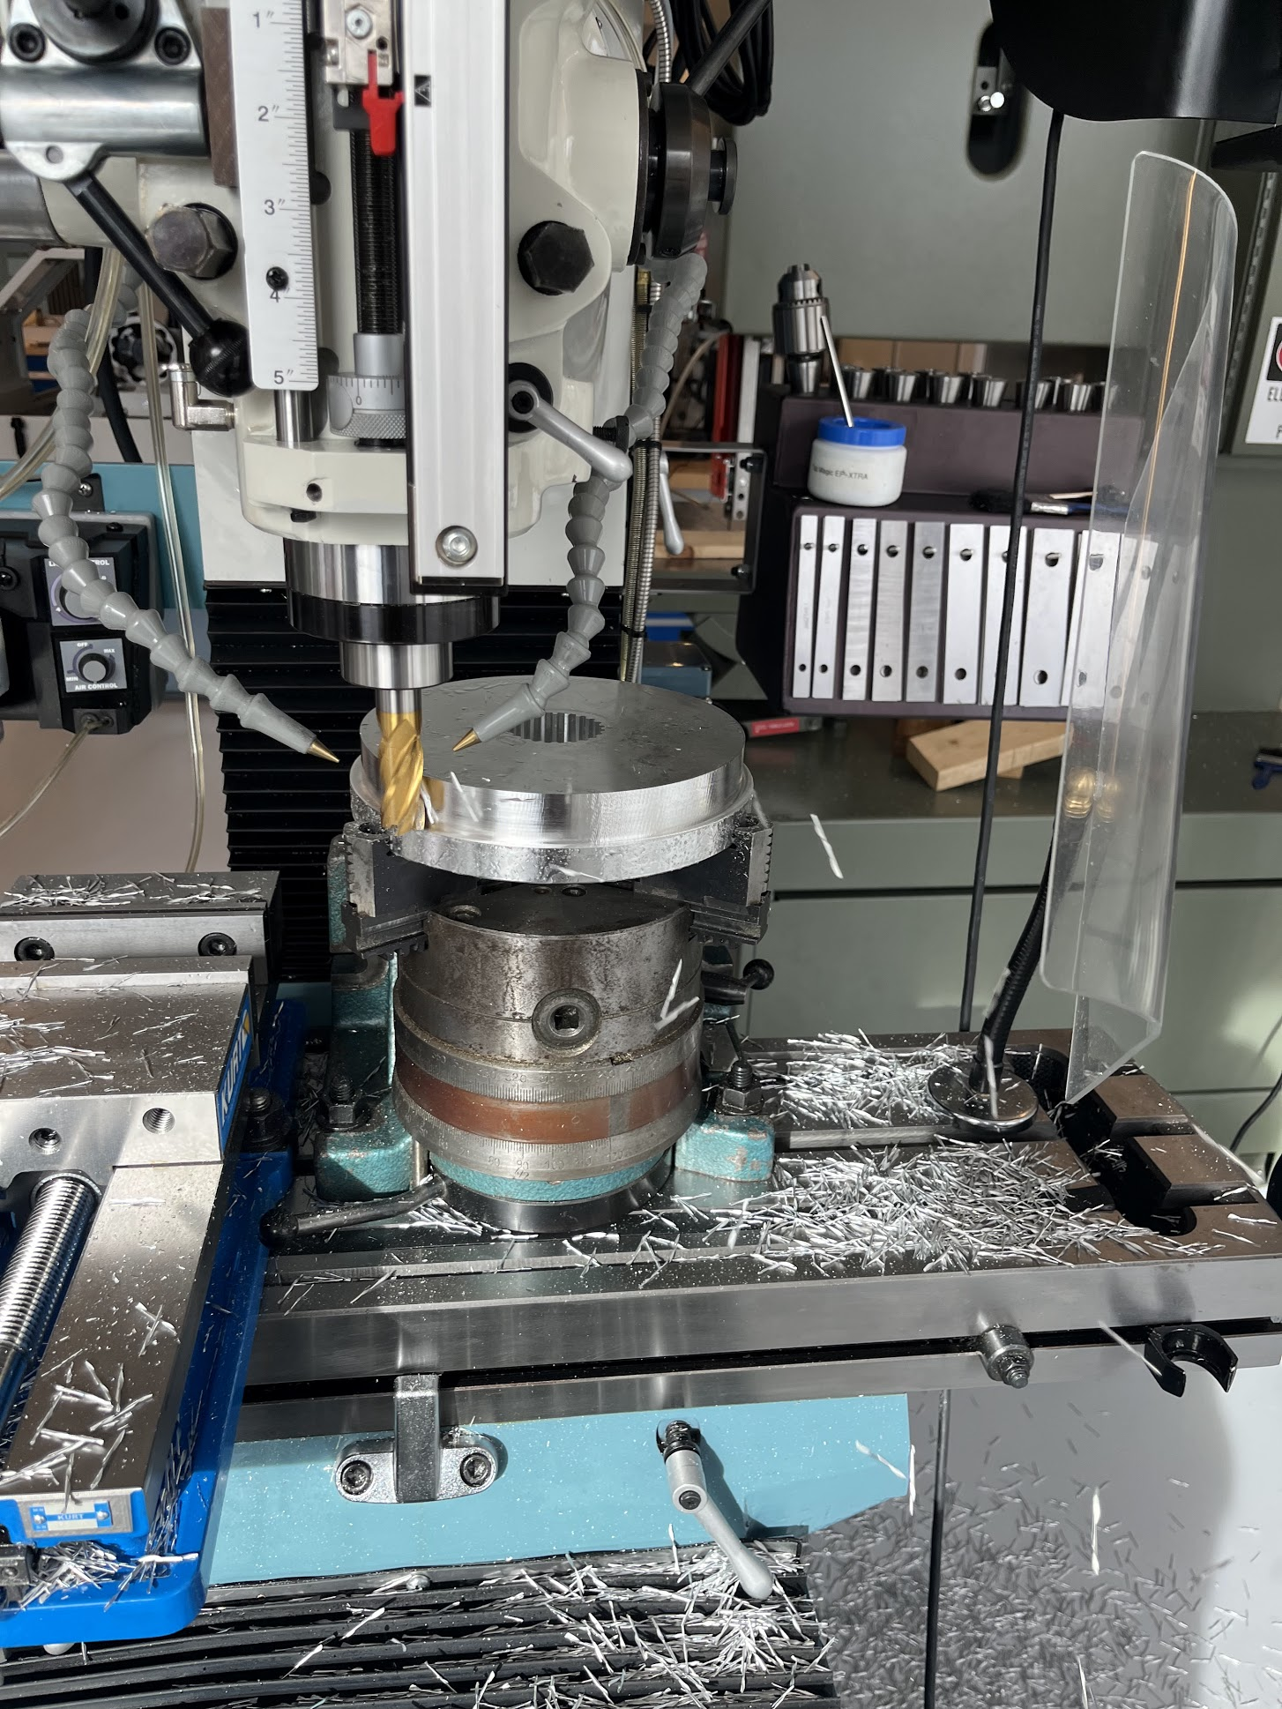
Machine Shop Parts

